Slide 1
do while loop
Your name here;

Slide 2
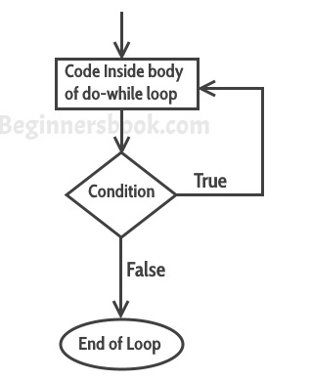
What is do while loop?
The do-while loop is a type of loop in programming that allows you to repeat a set of statements until a condition is met. The difference between a do-while loop and a regular while loop is that a do-while loop always executes at least once, even if the condition is false.
The do while loop flow chart:
The do/while loop is a variant of the while loop. This loop will
execute the code block once,
before checking if the condition is true, then it will repeat the loop as long as the condition is true.

Slide 3
What is do while loop?
Here's the basic syntax for a do-while loop:
do {
// statements to be executed
} while (condition);

Slide 4

Where you can run this code
For PHP:
XAMPP
https://www.onlinegdb.com/
For Java:
Eclipse
IntelliJ IDEA
https://www.onlinegdb.com/
For JavaScript:
Google Chrome

Slide 5

do while loop in
1. Example of do while loop in PHP
<?php
$count = 0; //initialization
do {
echo $count;
$count++;
} while ($count < 5); // condition
?>
Output:
01234
The statements inside the curly braces will be executed at least once, and then the condition is checked. If the condition is true, the statements will be executed again, and the process will continue until the condition is false.

Slide 6
do while loop in
2. Example of do while loop in PHP
<?php
$x = 6;
do {
echo "The number is: $x <br>";
$x++;
} while ($x <= 5);
?>
Output:
The number is: 6
This example sets the $x variable to 6, then it runs the loop, and then the condition is checked:

Slide 7
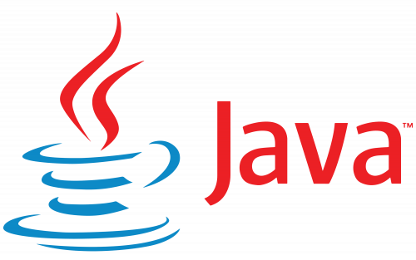
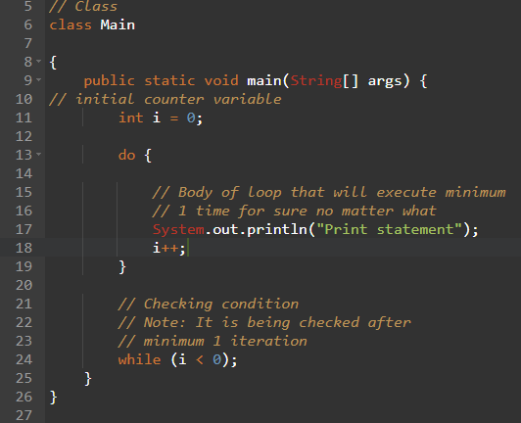
do while loop in
1. Example of do while loop in Java
Output:
Print Statement

Slide 8
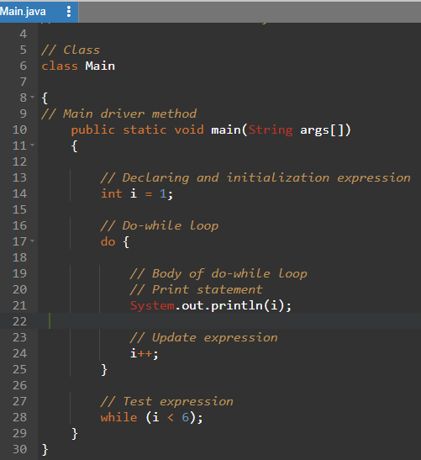
do while loop in
2. Example of do while loop in Java
Output:
1
2
3
4
5

Slide 9
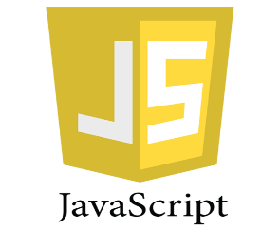
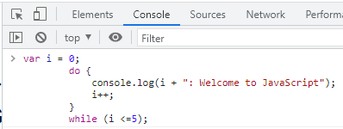
do while loop in
1. Example of do while loop in JavaScript
Output:
0: Welcome to JavaScript
1: Welcome to JavaScript
2: Welcome to JavaScript
3: Welcome to JavaScript
4: Welcome to JavaScript
5: Welcome to JavaScript

Slide 10
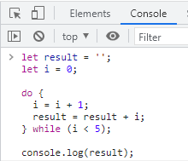
do while loop in
2. Example of do while loop in JavaScript
Output:
12345

Slide 11

Have a nice day!!!

